Slide 1
Pikes Peak Region Business Climate Survey Multi-Year Assessment 2009 - 2015
Compiled and Presented by
Tom Binnings
Senior Partner
Prepared
June 2018

Slide 2
Methodology

Slide 3
Past Surveys
2009 -- Focused on Establishing a baseline and considered the regulatory environment.
2011 -- Focused on Economic Vitality and drilled down on perceptions of regulations.
2013 -- Focused on the elements of a world-class business climate.
2015 – Focused on entrepreneurship in order to assess the start-up and small business ecosystem.

Slide 4
Collection Methodology
Numerous business groups and media outlets were invited to distribute the survey via an e-mail link. We tried using purchased mailing lists (in 2011) and social media (in 2015), but the click through rates were poor from those sources.
The business climate survey is subject to response bias as it is not a random survey. If it were a random survey it would provide a 95% confidence level +/- 6%. Given the participation of the Colorado Springs Chamber and EDC, there is strong repetitive response over the years from many of the same businesses thereby providing a decent look at trends in the business climate.
We track responses by industry and compare those responses to the Census Bureau’s County Business Patterns to determine over and under representation by industry (see the next 2 slides).

Slide 5
What industry is your organization in?
Compared to 2013 County Business Patterns (CBP) and Survey

Slide 6
Respondents by Size of Firm
With the exception of the 2009 survey, the distribution of survey respondents is consistent from year to year. In all years the survey is biased to larger firms when compared to the 2013 Census Bureau’s count of firms by number of employees. This is due to strong participation by the CSCEDC.

Slide 7
Respondents by Type
All surveys since 2009 have sought responses from business owners, executives, and area managers of regional, national, or international organizations. In 2013, people who did not meet that classification (Other) were added to get a different set of responses from them and to not disqualify respondents on the first question.
Survey Flow by Respondent Type
The survey is targeted to take 8 to 10 minutes.
Business Climate
Historical Questions for Comparison
Owners/ Executives/ Senior Managers
Workforce Question Set A
Workforce Question Set B
Other
Economic Goals

Slide 8
Key Findings Over the Years

Slide 9
Contribution to Economic Base of Community
All economies are based on exports bringing incomes into a community from the rest of the world. Firms with local sales indirectly rely on the export sector.
In Teller and El Paso Counties combined, the larger firms appear to have a greater percent of sales from exports – perhaps rivaled by mid-sized firms.

Slide 10
How would you rate your satisfaction with the overall business climate in the Pikes Peak Region ?
For the first time since 2009 the business community has become more satisfied with the overall business climate in the region. Satisfaction levels were consistent among all respondent types.

Slide 11
How would you rate the local business climate in the Pikes Peak Region compared to two years ago?
There is a clear trend over the last six years with more respondents seeing the business climate getting better. The improvement is especially notable in the last two years.

Slide 12
How would you rate the business climate in the Pikes Peak Region related to the following.
Leverage Point
Constraints to Improve
Problem
Half of the indicators show improvement (Gold) while one got worse (Blue).
Scores can range from 2 to -2.

Slide 13
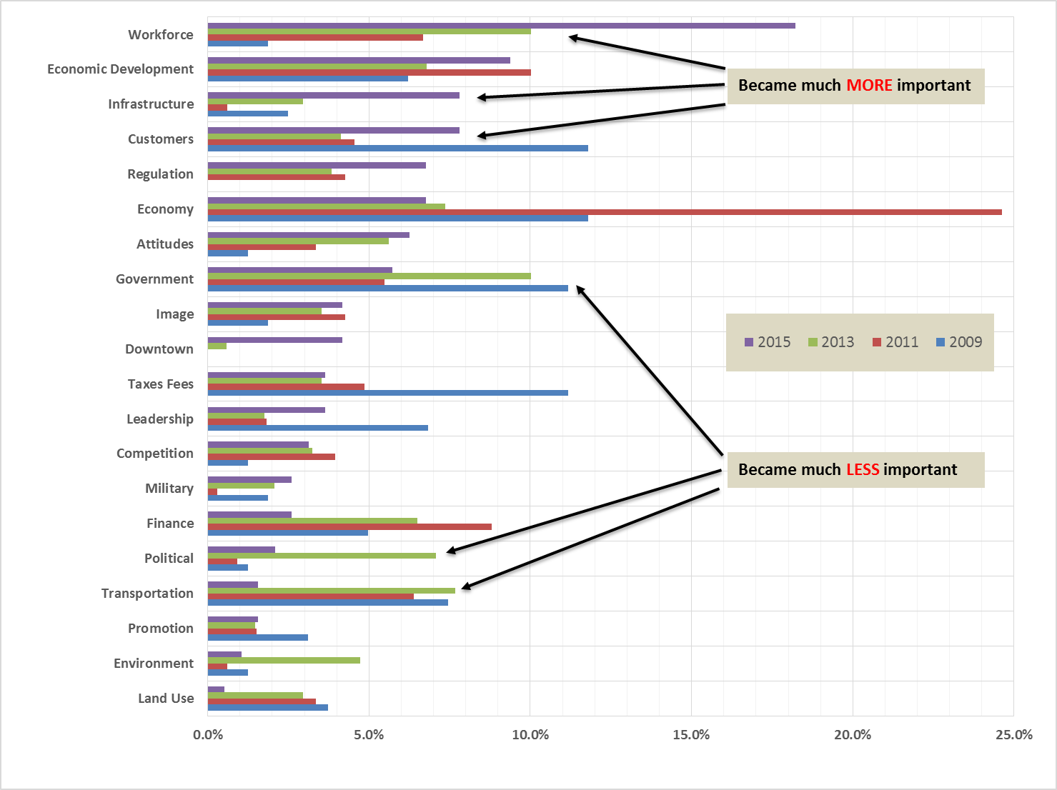
Top problem/barrier in doing business from El Paso/Teller Location.

Slide 14
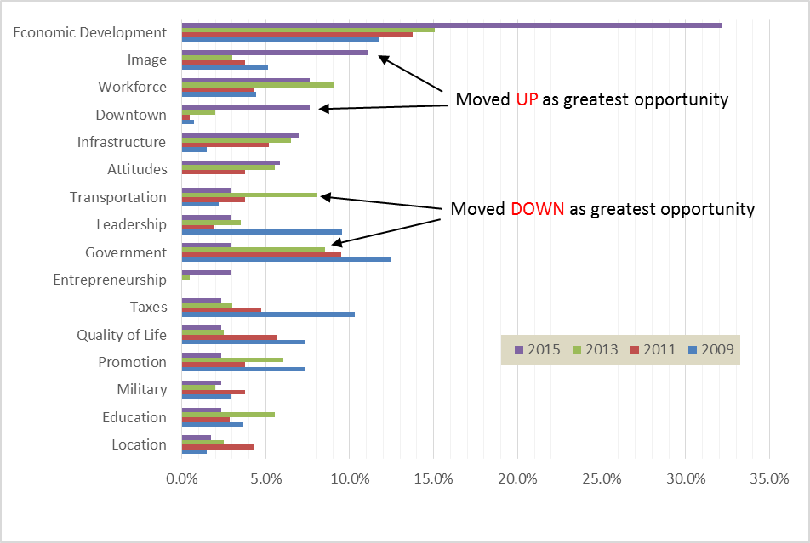
Greatest opportunity to improve to world class business climate

Slide 15
Pick what you think the TOP FIVE economic development goals should be for the P.P. Region
Top 12 preferences among respondents who were NOT self-employed, a business owner, executive, or top local manager for a regional, national, or international operation. Respondents were largely other managers, supervisors, and salaried workers.

Slide 16
50% of 185 Respondents in 2015 indicated their organization experienced difficulties matching job requirements with qualified job applicants. The percentage has not significantly changed since 2013.
Positions most difficult to fill with qualified candidates
The healthcare sector was underrepresented in the survey.

Slide 17
Growth prospects in coming two years
From 2015 survey
Growth Drivers

Slide 18
What are the most significant challenges to the future growth and survival of your business?
Question asked by National Small Business Association in their 2011 Taxation Survey. Respondents could select as many as applicable.
Pikes Peak Region businesses are relatively more challenged by capital, qualified workers and technology and less challenged by Federal taxes.
From 2011 BCS

Slide 19
What is the largest burden posed to you by the federal tax code?
Region’s responses are very similar to NSBA except for slightly greater administrative burden
From 2011 BCS

